Slide 1
Project Beta
Buy or Sell?
Using Machine Learning models to predict the best time to buy
or sell Apple stock

Slide 2
Agenda
Overview
Data Search and Cleaning
ML Models used (RNN LSTM and Beta-t-EGARCH)
Applying SMA on predicted data
Backtesting and measuring results
Automation and future improvements
Challenges and future improvements

Slide 3
The Question - Which is better?
Option 1
Option 2
Buying and holding Apple stock?
Using ML to buy and sell Apple stock?

Slide 4
How it works
Use 20 and 10 day SMA for the predicted LSTM daily close result and report signal when they cross.
Deploy a websocket to monitor intraday market and take advantage of unexpected market moves.
Gathering closing data for Apple and related companies
Step 1
Step 2
Step 3
Step 4
Step 5
Forecast close price of Apple using LSTM model on last 3 years of lagged close prices of Apple and various relevant stocks
Apply those signals to execute the orders, backtest it and report results.

Slide 5
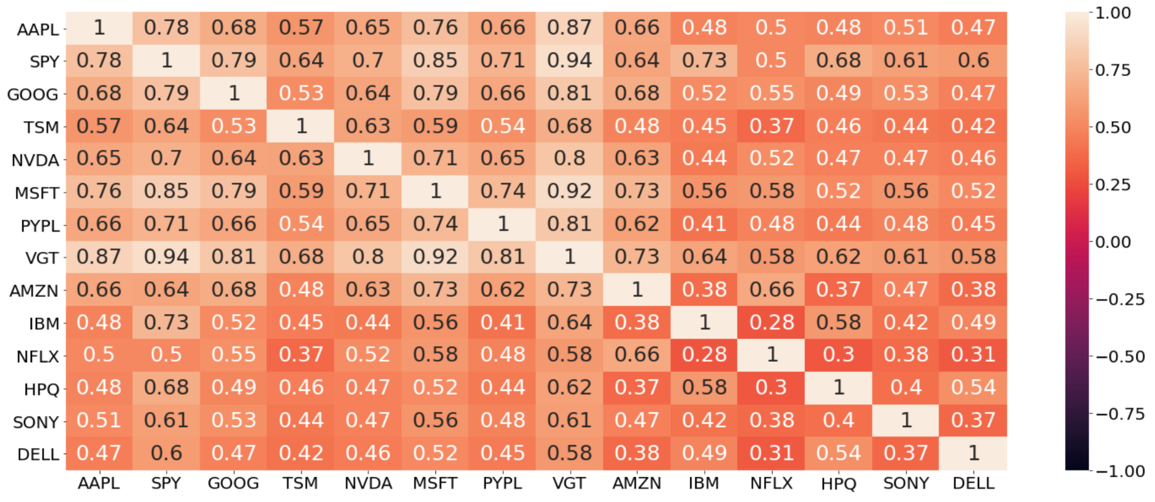
The Data - What inputs did our model learn from?

Slide 6
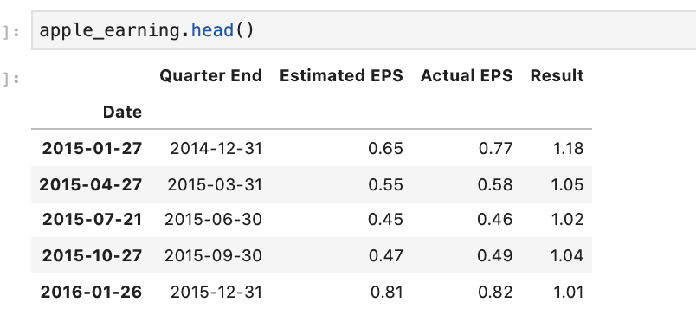
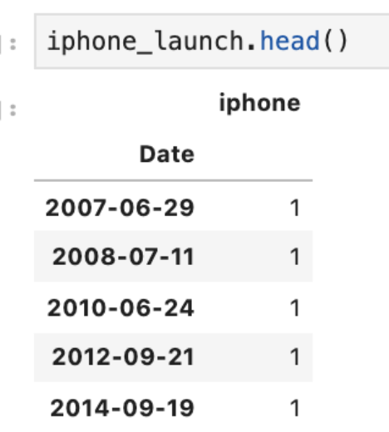
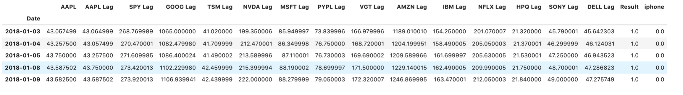
The Data - What inputs did our model learn from?

Slide 7

Our Models:
Tensorflow.Keras LSTM
Beta-t-EGARCH
The Tensorflow LSTM model is widely used when trying to predict stock prices.
Since our data is autoregressive we used it to predict the closing price of Apple stock
Beta-t-EGARCH focuses primarily on stabilizing volatility.
Using Beta-t-EGARCH helps us identify outliers and not react sharply to large swings and random events - which will be helpful automating in the future.
PyFlux

Slide 8
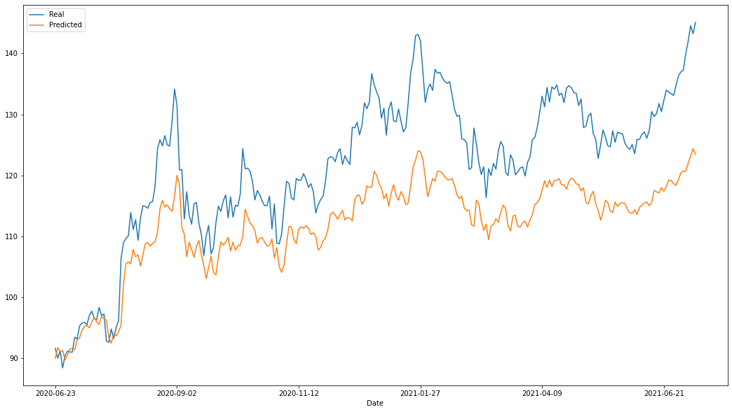
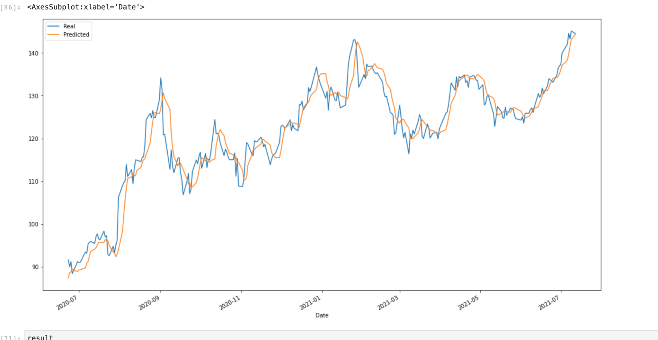
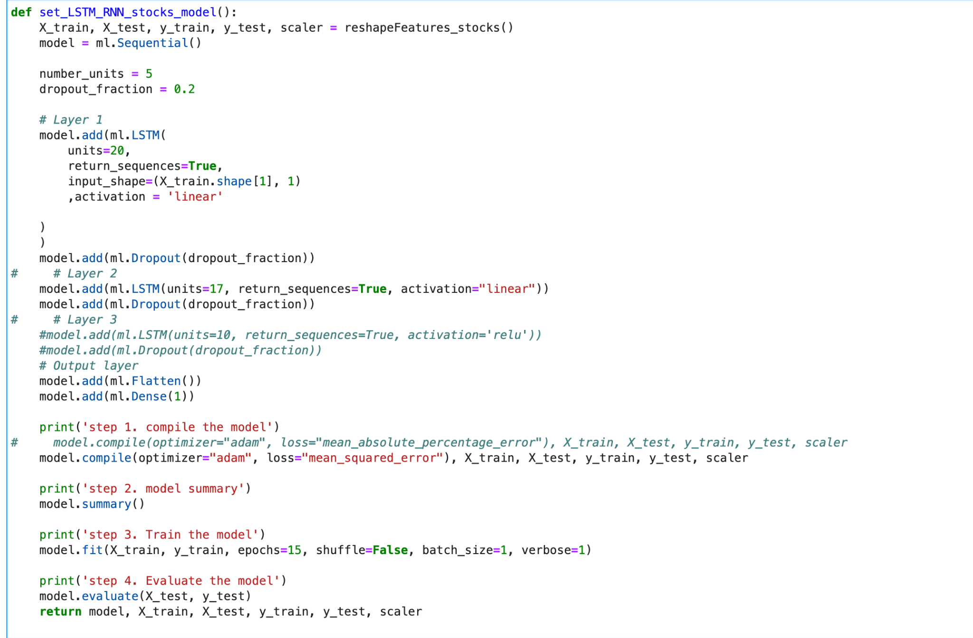
Tensorflow.Keras LSTM

Slide 9
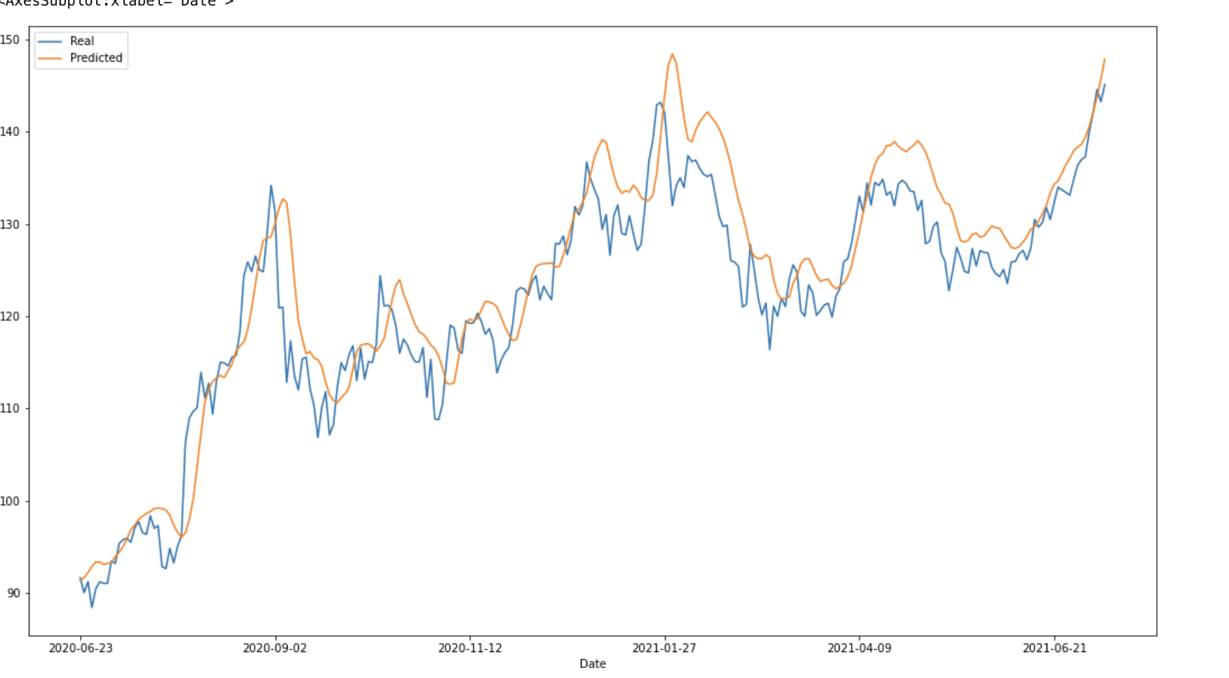
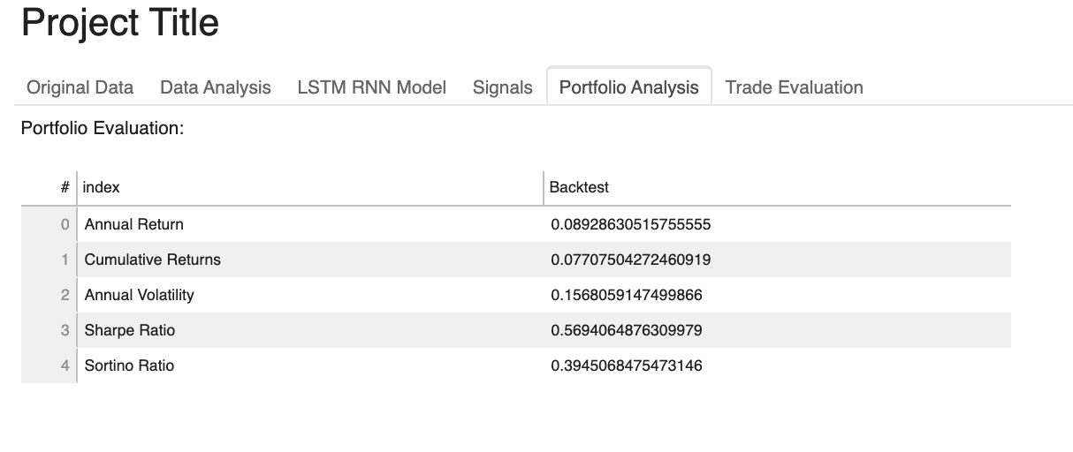
Tensorflow.Keras LSTM
Alternative Try

Slide 10
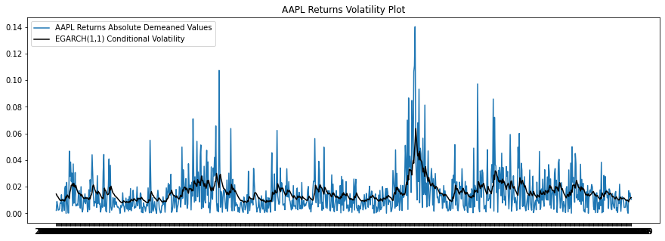
Beta-t-EGARCH

Slide 11
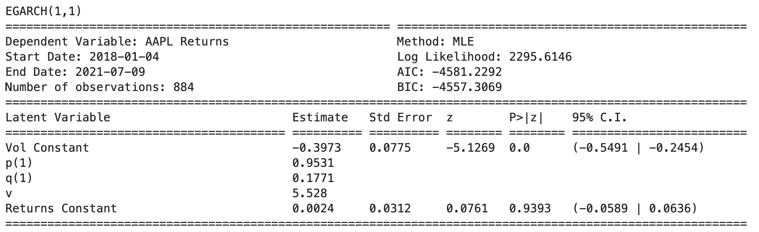
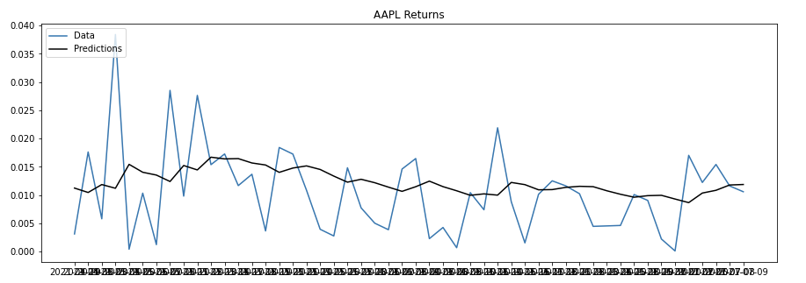
Beta-t-EGARCH

Slide 12
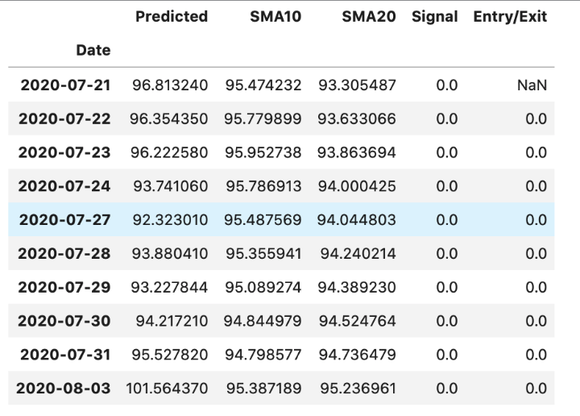
Data Preparation and Model Training

Slide 13
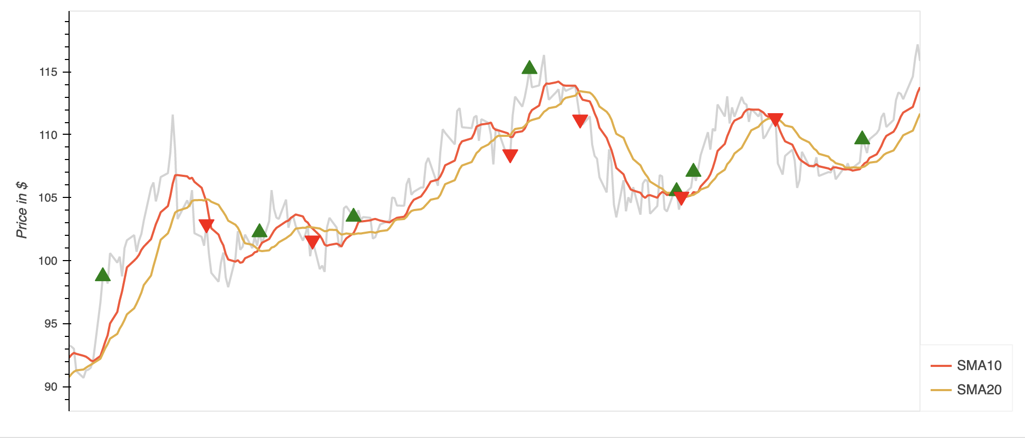
SMA 20/10

Slide 14
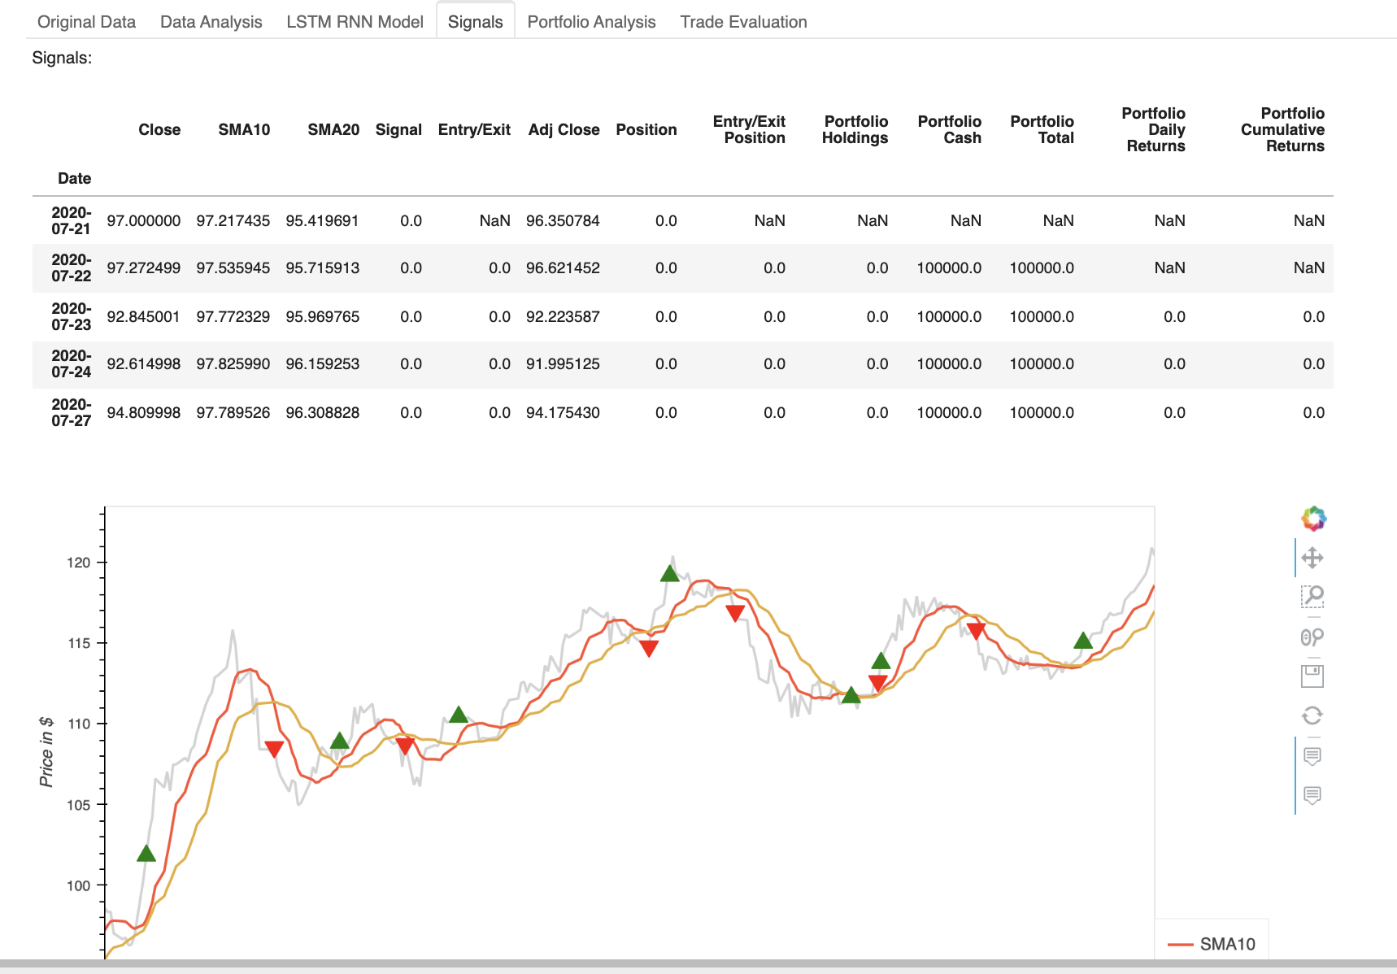
Evaluation - How did we measure performance?

Slide 15
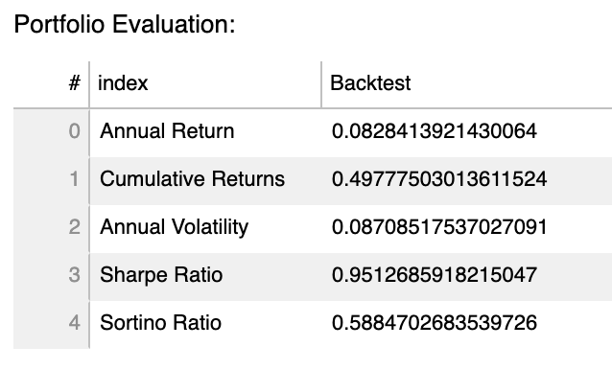
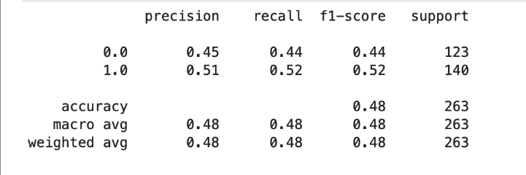
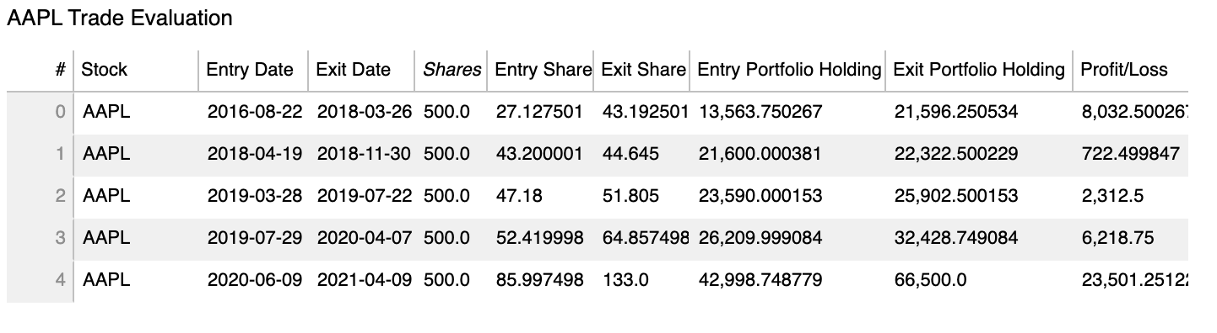
Results of Back Tested Data and Real Time Performance

Slide 16
Automation 1
COMPUTER
ML Model
ALPACA
Trades
YFinance
CSV
Buy/Sell
Orders
API
Buy/Sell
Alpaca API Format
GOOGLE CLOUD
Functions
Alpaca Translator API

Slide 17
Automation 2
ALPACA
Trades
Buy/Sell
Alpaca API Format
YTicker
Ticker Value
GOOGLE CLOUD
Functions
Alpaca Translator API
Account
Updates
COMPUTER
ML Model
Buy/Sell
Orders
API
Websocket
Intraday
Ticker Value

Slide 18

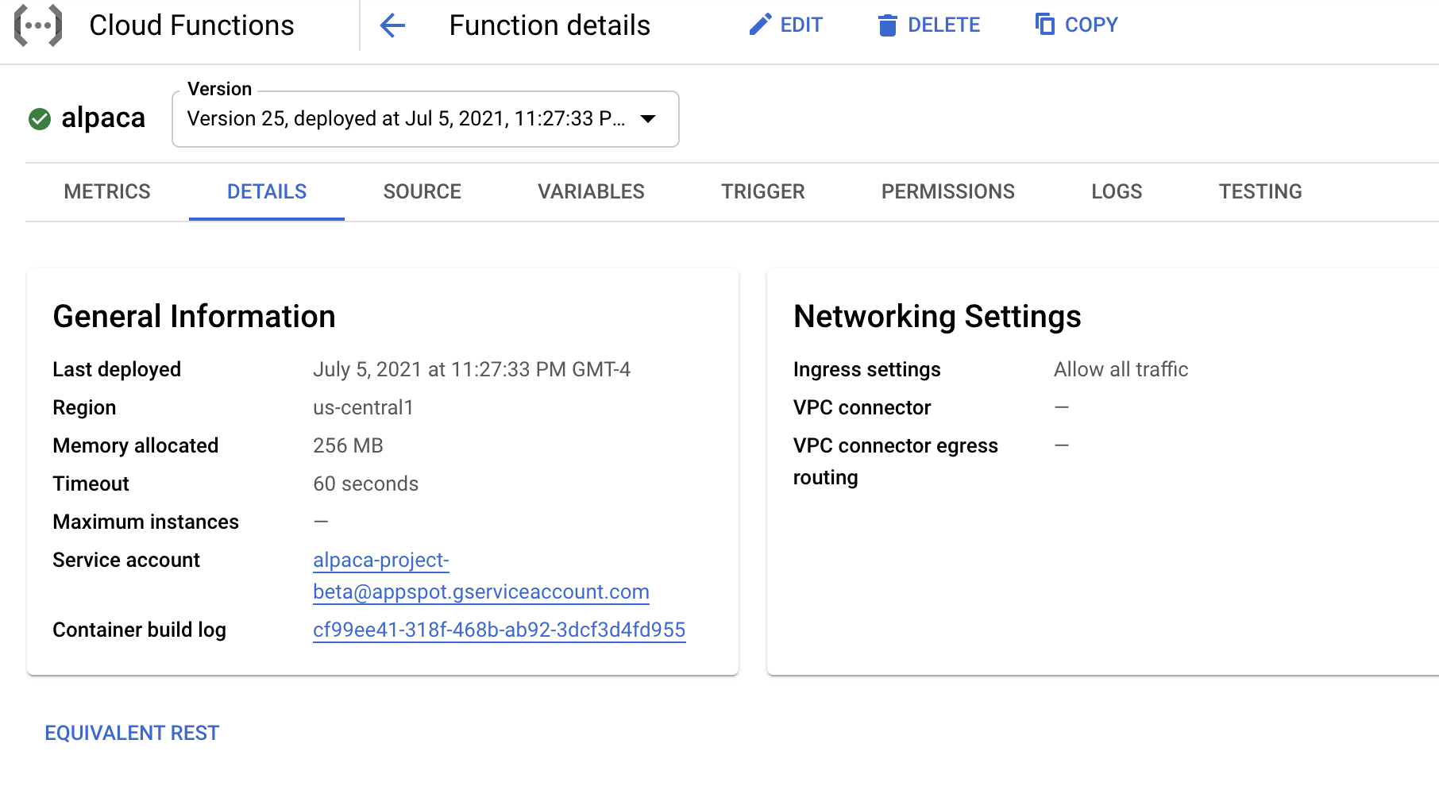
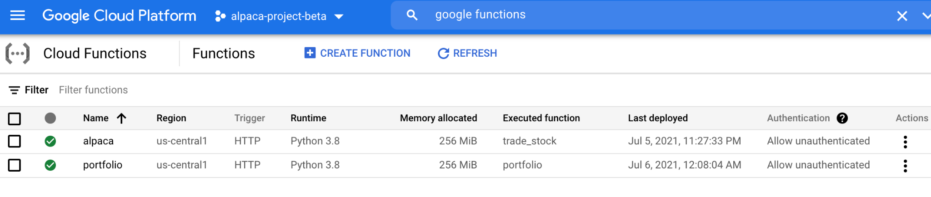

Slide 19
Improvements
Include more data (RSI. MACD, Bollinger Bands … )
Different SMA Intervals
Other ML Models
Different combinations of models and technical analysis
Improve performance trackers
Deploy the entire application in the cloud with redundancies

Slide 20
Open Discussion
...and how to improve moving forward

Slide 21
Thank you
Sources
https://pyflux.readthedocs.io/en/latest/egarch.html
https://towardsdatascience.com/time-series-forecasting-with-2d-convolutions-4f1a0f33dff6
https://deepdatascience.wordpress.com/2016/11/18/which-lstm-optimizer-to-use/
https://towardsdatascience.com/metrics-to-evaluate-your-machine-learning-algorithm-f10ba6e38234
https://pypi.org/project/yfinance
https://core.ac.uk/download/pdf/42337476.pdf

